Slide 1
School Safety Day
St. Louis Archdiocese - School Safety Day
Threat Assessment and Reporting

Slide 2
Today’s Agenda:
0800-0830 Arrival and check-in
0830-0845 Welcome and
Introductions
0845-0900 Overview of the Day and CrisisGo Overview
0900-1000 SRPs
1000-1015 Break
1015-1130 EOPs
1130-1230 Lunch
1230-1:30 Tip Reporting
1:30-1:45 Break
1:45-2:45 Safe2SpeakUp Overview and what to expect
2:45-3:30 Project Overview and expectations
3:30 Wrap-up/Evaluations

Slide 3

Welcome and Introductions
0830-0845:
CrisisGo Staff
Principals
Safety Staff
High School
Elementary/Middle School
Years

Slide 4





CrisisGo
Focus on school and workplace safety since 2013
Headquarters located in Clayton, MO
100% Uptime for 5 consecutive years
Secure platform; cloud based and geo-redundancy
AWS Public Safety and Disaster Response Partner
16k+ Organizations
50 States
33 Countries
10 Years
Notes:
AWS Verizon ILUGs Pasco Co Fulton Co

Slide 5
Considerations
Adoption of Tip Reporting from parents, staff, and students
Universal and up-to-date safety language and protocols
Are all Archdiocese schools practicing drills
Response Times – 75% of Active Shooter incidents occur in the first 5 minutes
Liabilities
Are we effectively accounting for staff and students
What integrations are needed with today’s systems
Enrollment and Community perception
16k+ Organizations
50 States
33 Countries
10 Years

Slide 6



CRISISGO ACCESSIBILITY
4G
5G
LAPTOP & DESKTOP
Apple, PC, Chromebook
SMARTPHONE & TABLET
iOS, Android
Notes:
Cloud based, not on your servers. Encrypted, ferpa compliant, coppa compliant, we are just the medium for your information, we don’t sell, share, or advertise with your information BUT, it is important to know that you can have CrisisGo on multiple devices – simultaneously. So your PC, Mac, Chromebooks – but also your mobile devices.

Slide 7
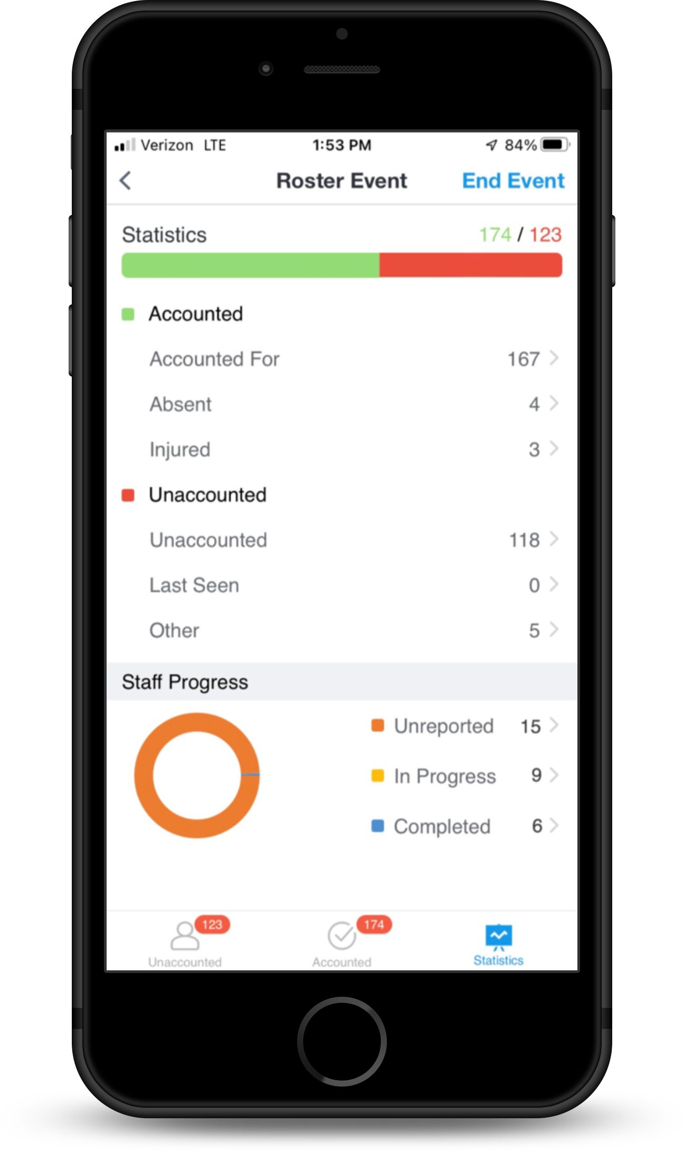
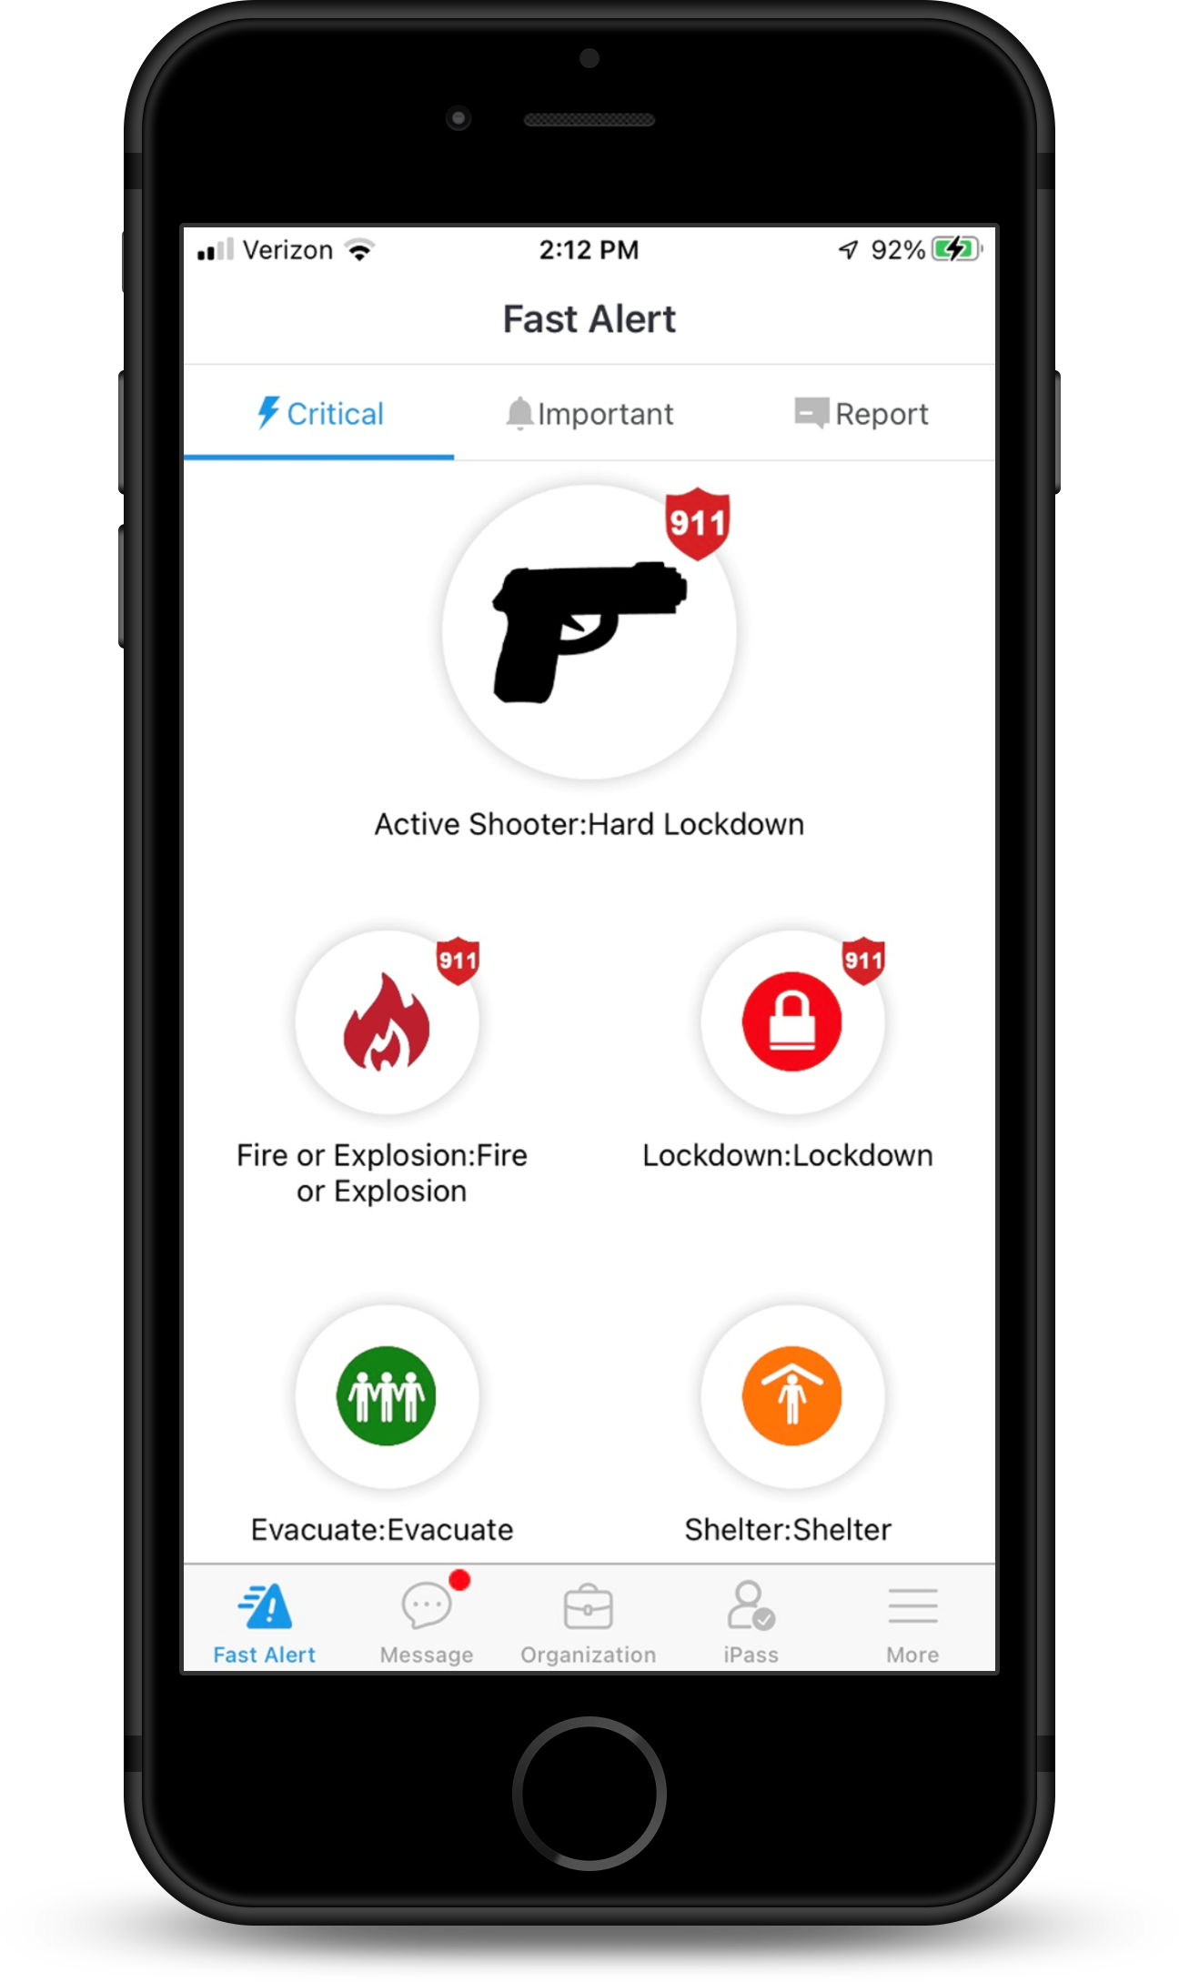

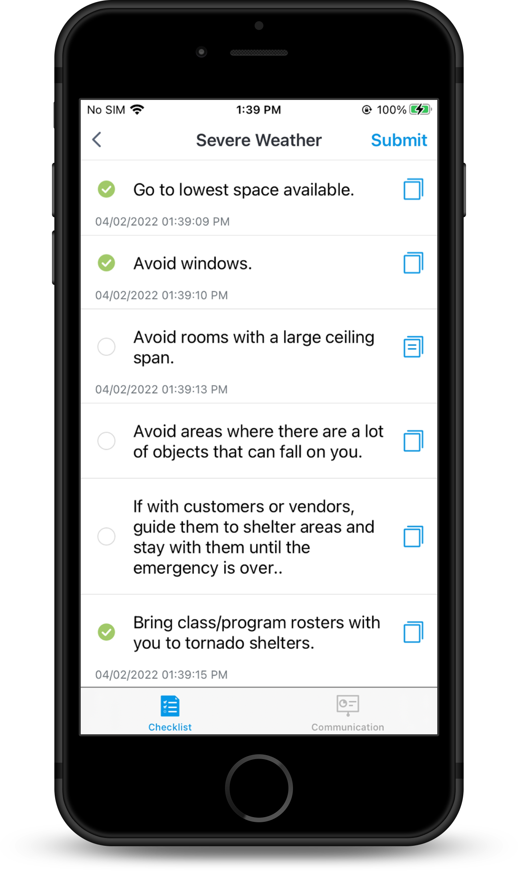
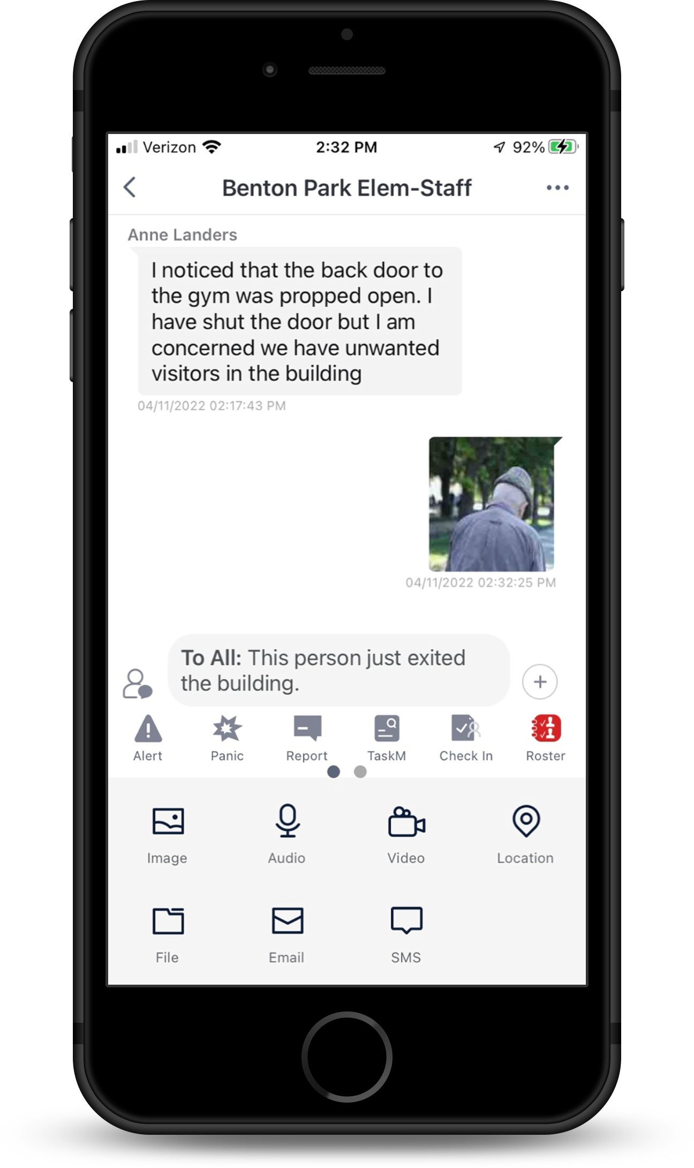
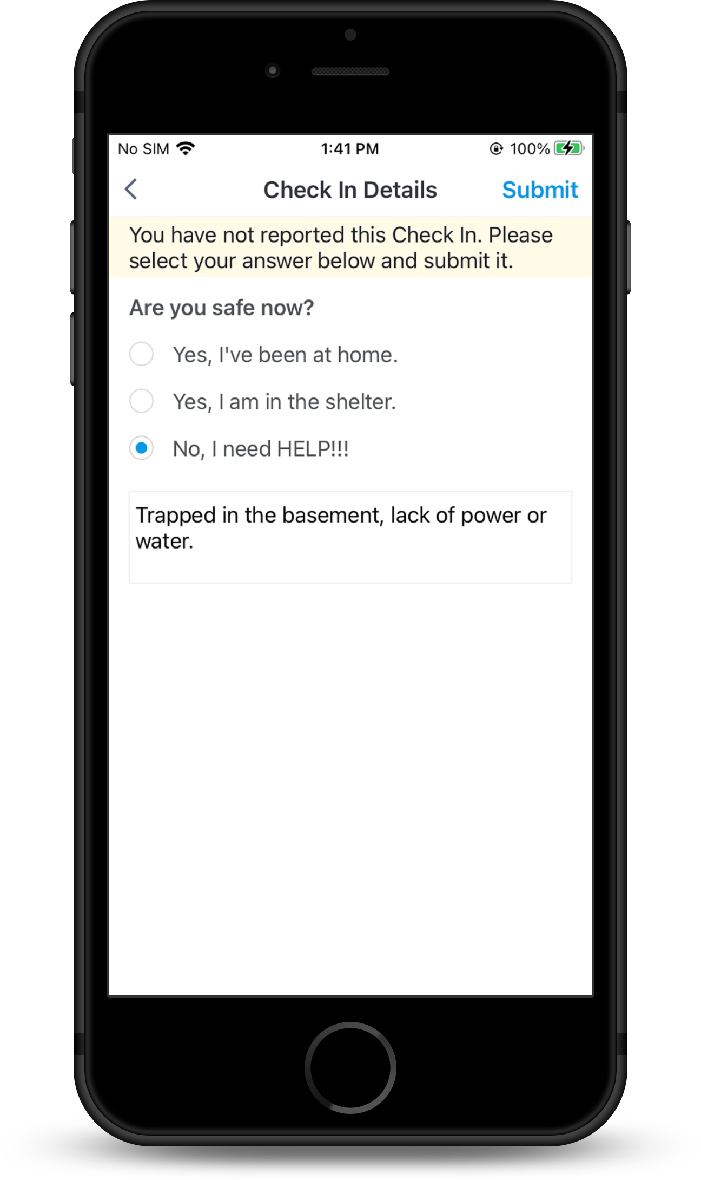
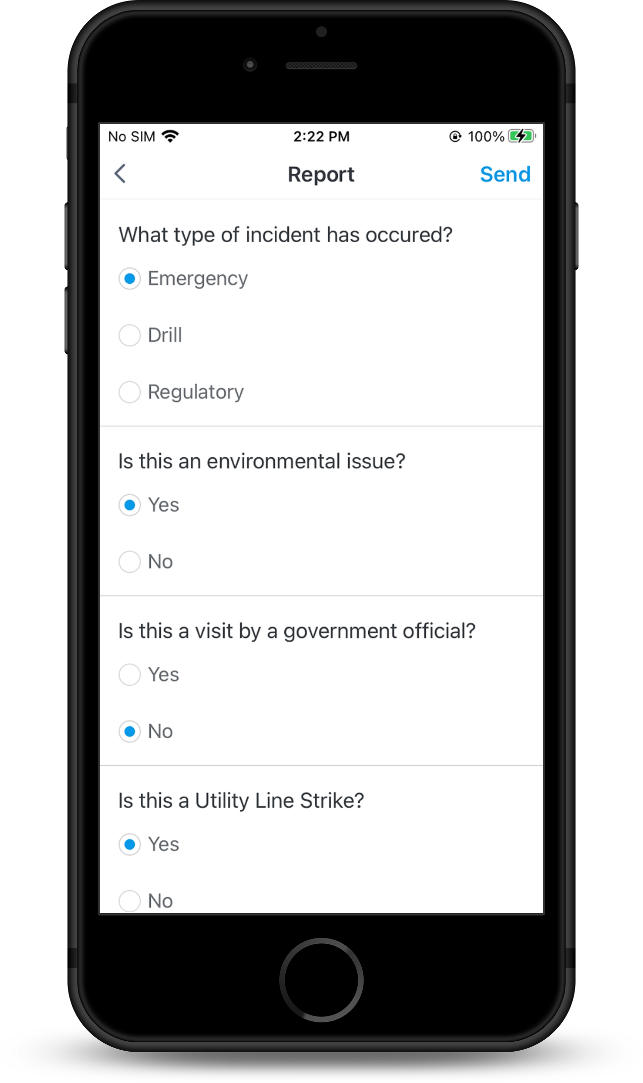
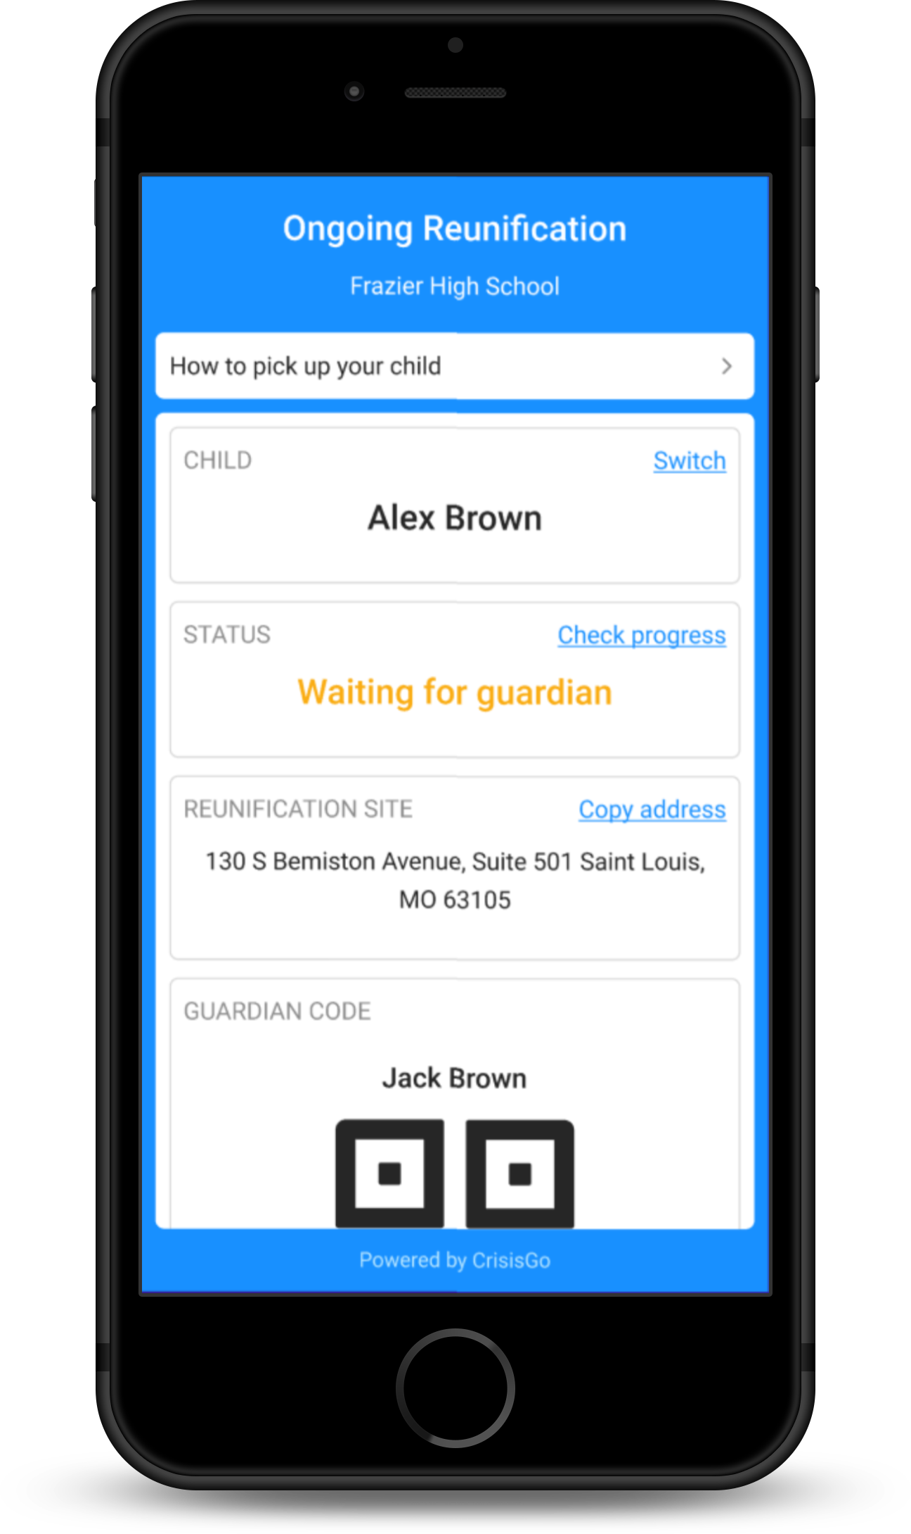
CUSTOMER DRIVEN NEW FEATURES
Maps/Doc
Emergency Contact
Roster Event
Alert
Checklist
Check In
Reunification
Threat/Bully Report
Communication
Notes:
Integrations, TA

Slide 8




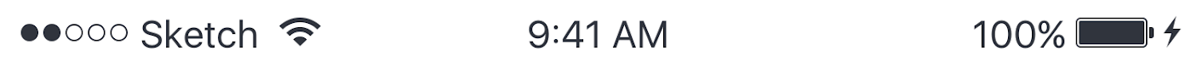
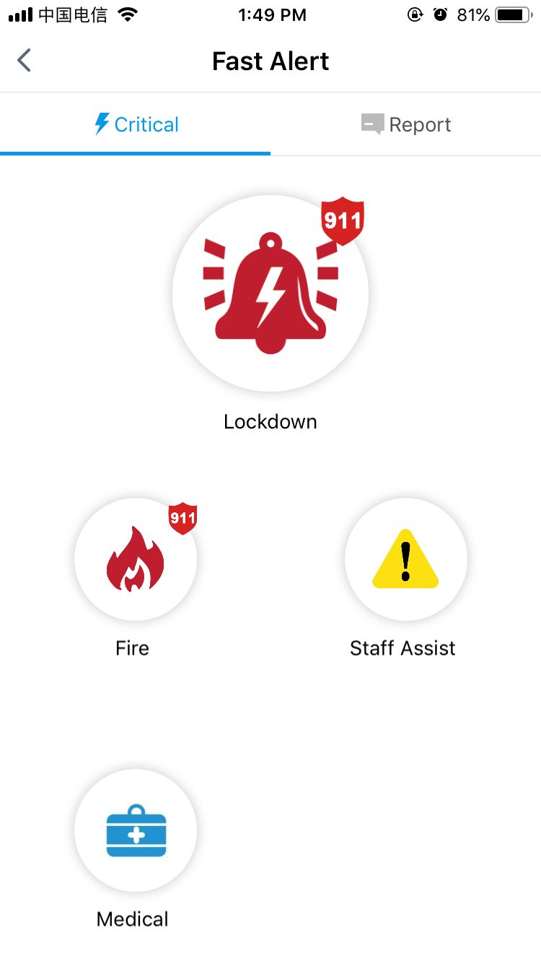






Automatic Escalation
Notes:
Based on the alert types, administrators and local first responders are automatically and immediately joined into the group communications and may have direct access with all members of the group during the crisis.

Slide 9

Student-Specific App
Safe2SpeakUp
Comprehensive Student Safety Application
Makes students part of your safety plans
Helps account for students during an incident SAFE2SPEAKUP
GPS can be used to locate students that fled in a critical situation
COPPA compliant

Slide 10
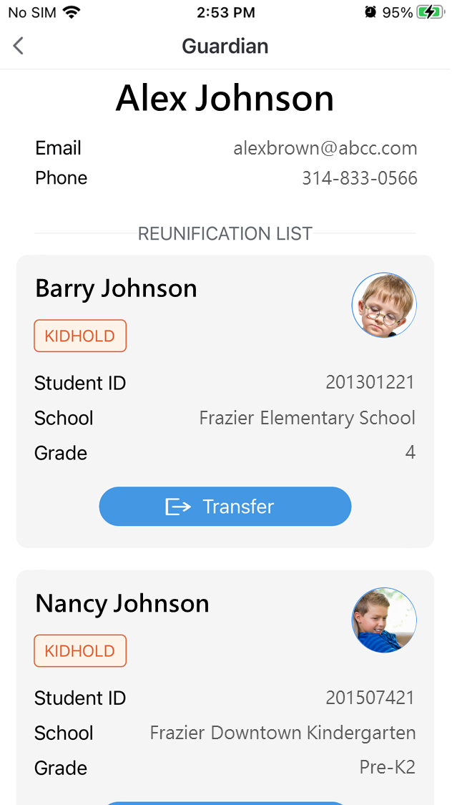
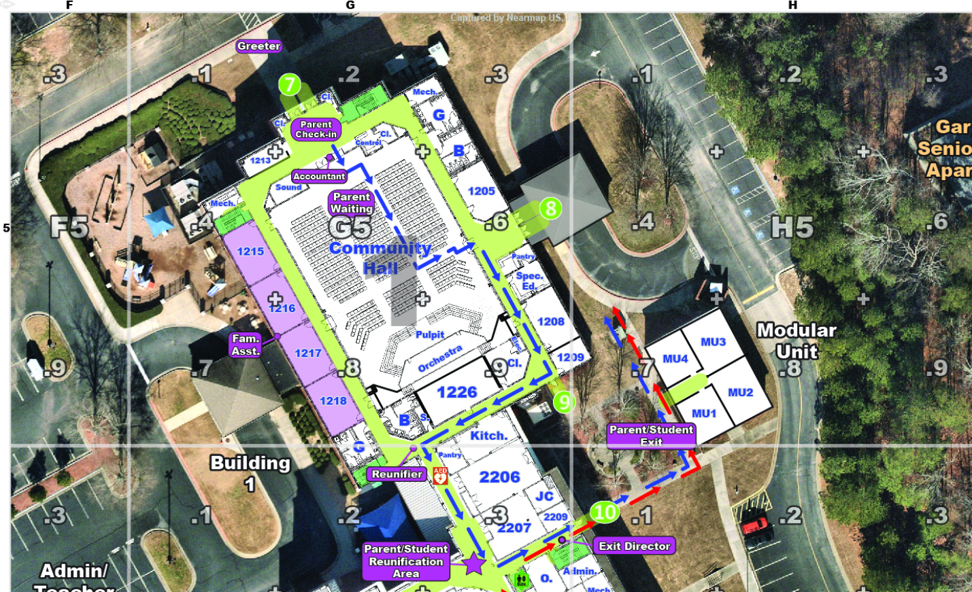
Mapping
School staff managing Reunification via CrisisGo app.

Slide 11
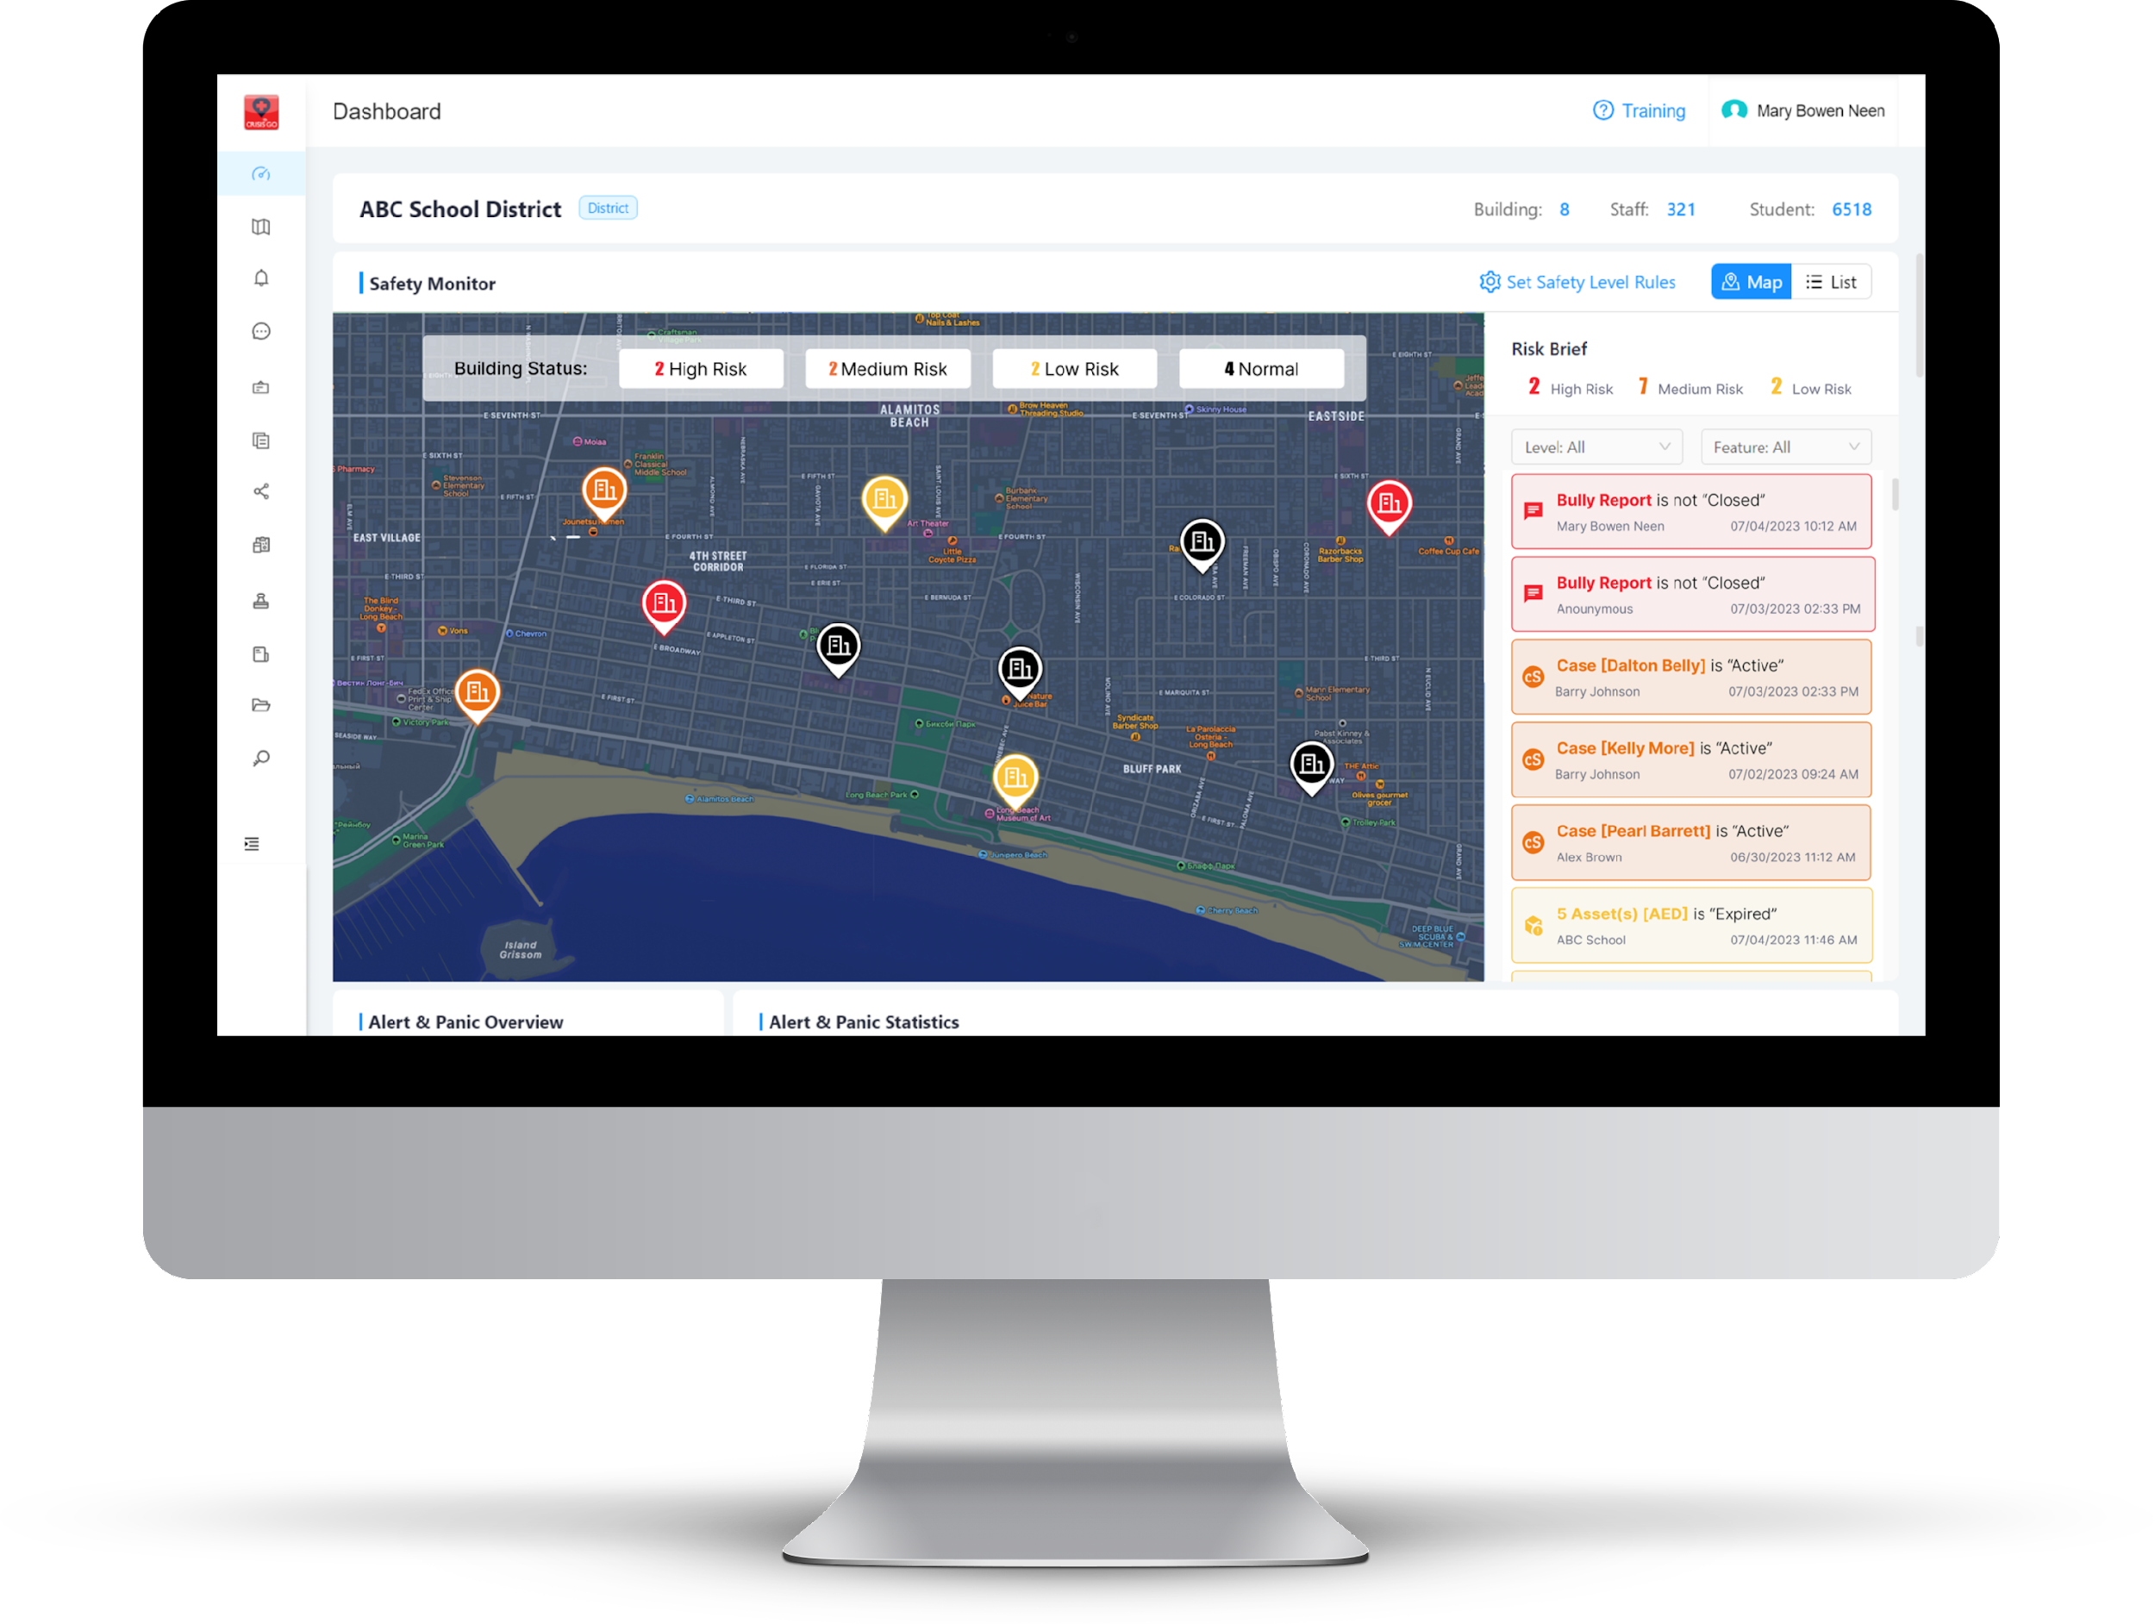

SAFETY COMPLIANCE & MANAGEMENT
Recognize, supervise, intervene. Real-time risk and compliance management all in one place.
School Risk
School Safety Event
Tip/Bully Report
Mental Health Case
Safety Asset Risk
Safety Compliance
Safety Audit & Assessment
Notes:
With the School Risk Response Dashboard, it's as simple as a glance. Every safety item, every detail – all neatly organized and accessible, tailored to the accountable role from principal to District Safety Leaders, area Superintendents and Superintendent. Monitor bullying reports, threat assessments, and drill compliance with color-coded warning indicators. These indicators signify the levels of risk for incidents or compliance issues. Instantly recognize and prioritize critical matters.

Slide 12


PROJECT PLAN & DEDICATED AM
Project Manager
Account Manager
Dedicated Project Manager to lead you through the implementation of your CrisisGo Solution.
Dedicated Account Manager to support you as an advocate for your needs throughout your relationship with CrisisGo.
Project Kickoff
IT Configuration
Solution Setup
System Training
Communication Planning
Assistance with Deployment and Adoption
Notification of Product Enhancements
Escalation Point of Contact
Ongoing Conversations to Understand how CrisisGo can Support you

Slide 13
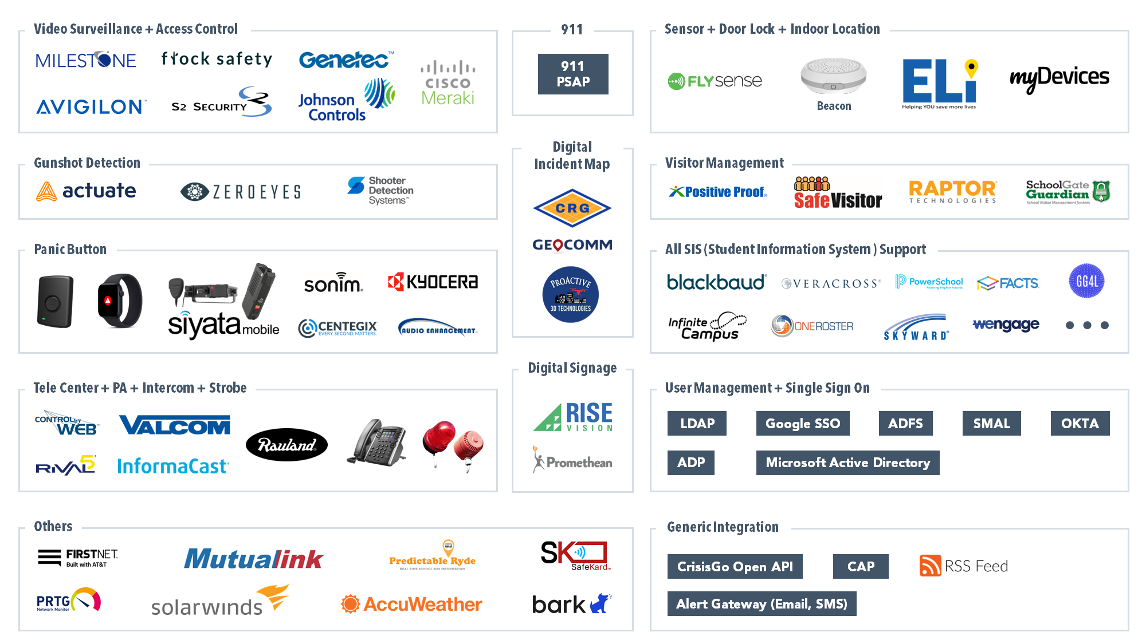
INTEGRATED SCHOOL SAFETY SYSTEM

Slide 14
Overview of the day; This is for YOU!
Emergency Protective Actions- Standard Response Protocols
Emergency Operations Plans
Anonymous Tip Reporting and Concerning Behavior
Safe2SpeakUp
CrisisGo Process Overview
Wrap-up / Evaluations
Bonus Session, If time permits: Reunification

Slide 15
Emergency Protective Actions (EPA)
Standard Response Protocols (SRP)
St. Louis Archdiocese - School Safety Day
www.iloveuguys.org

Slide 16

Contradictions?
Nothing is 100%
Emergency Solutions are non-binary (this or that, right or wrong)
There are answers that are less or more dangerous
Everyone as an opinion

Slide 17
Emergency Protective Actions
Emergency Protective Actions (EPA) are actions that is taken by a person(s) to prevent and/or mitigate injuries/fatalities for themselves or others; regardless of their titles. Everyone needs to know what they are and when to use them.
Standard Response Protocols are a standardized set of EPAs developed for use in the K-12 and other community sectors, by the “I Love U Guys” Foundation; www.iloveuguys.org

Slide 18

Lockdown: Locks, Lights, Out of Sight!
Lock down is called when there is a threat or hazard inside the building. From parental disputes, intruders, to active shooters. Lockdown uses classroom and school security actions to protect students and staff from the threat.

Slide 19
Lockdown: Locks, Lights, Out of Sight!
Action demands locking individual classroom doors and other securable areas, moving occupants of the line of sight and turning off lights to make the room seem unoccupied.
No call to action to secure exterior doors, leave as is. This reduces exposure and allow First Responders access.

Slide 20

Secure: Get Inside Lock Outside Doors!
Secure is called when there is a threat or hazard outside of the building. Whether it’s due to violence, criminal activity near or a dangerous animal on the playground, Secure uses the security of the physical facility to act as protection

Slide 21
Secure: Get Inside Lock Outside Doors!
Secure demands bringing people into a secure building and locking all outside access points.
Where possible, classroom activities should continue.
For classes outside, they should be brought inside and continue inside the building.

Slide 22

Evacuate: To a location.
Evacuate is issued when there is a need to move people from one location to another for safety reasons.

Slide 23
Evacuate: To a location.
Evacuate demands students and staff move in an orderly fashion to a safe area:
Onsite: Minor fires, power outages, other school disruptions
Offsite: gas leaks, bomb threats, other instances when it is no longer safe to remain onsite.

Slide 24

Shelter: State Hazard and Safety Strategy
Shelter is called when specific protective actions are needed based on a threat or hazard. Additional training should be given to respond to tornadoes, earthquakes, hazardous material situations or other local threats

Slide 25
Shelter: State Hazard and Safety Strategy
Collaboration with local responders, the National Weather Service, and other local (OEM), regional and state resources will help in developing specific actions for your schools

Slide 26

Hold: In your room or area; clear halls
Hold is called when there are situations that require students and staff to remain in their classrooms or stay out of access areas. For example, an altercation in the hallway may require keeping students out of the halls until the situation have been resolved.

Slide 27
Hold: In your room or area; clear halls
Students and staff are to remain in their classroom or area, even if there is a scheduled class change until the all-clear is given.
Altercation in the hallway
Medical emergencies
Maintenance concerns in common areas during class

Slide 28
Run, Hide, Fight and Standardization
Run, Hide, Fight are EPA’s that were bundled together for the purpose of having different options based on Your circumstances. That being said, Jaclyn SchildKraut has determined that being behind a locked door is your best option
Standardization allows for everyone to be on the same sheet of music:
Student relocation
Staff relocation
Substitutes
First Responders
Families/Parents
Administration/Safety Teams

Slide 29
Break
Be Back in 15 minutes

Slide 30
Emergency Operations Plans: What they are and how they are created
St. Louis Archdiocese - School Safety Day

Slide 31
Emergency Operations Plans: What they are
Emergency Operations Plans (EOP)are, as the name suggests, plans you create to conduct operations during an emergency. The EOPs are meant to provide people with guidelines on how to respond in the event of an emergency. They often delineate procedures, expectations, roles and responsibilities and other components necessary to successfully respond to and manage an emergency event. EOPs are where you tell everyone what and how to do everything they are required accomplish during an emergency. Most states require an All-Hazards Plan: www.schoolsafety.gov for school safety resources

Slide 32
Problem Solving
Model
Identify
Identify the problem and the resources needed to address the problem
Transition
Develop a Plan
Transition to the new plan
Develop a plan or course of action and its alternatives
Observe
Implement
Observe the results of your plan, determine what adjustments are needed to improve
Implement your chosen plan

Slide 33
Emergency Planning Process
Prevention - Stopping the emergency before it happens
Mitigation - Taking steps to minimize the potential from it occurring and/or the impacts should it occur
Preparation - Training to increase your knowledge, Skills, and competency should something occur
Response - In the event something happens, what your actions are going to be to meet your expectations and responsibilities
Recovery - The process by which you undertake to return to a state of normalcy, or as close to normalcy as possible
SWOT

Slide 34
Emergency Operations Plans: How they are created.
Don’t Reinvent the Wheel. Look at those resources that are already available on the internet.
Create a high-level Scenario
Determine the triggers
How do you alert staff
How you want people to respond; step-by-step
Include all your requirements: EPA, 9-1-1, Communications, student and staff accountability, administration notifications, parent and community notifications
Don’t forget those with Access and Functional Needs
Reunification and Recovery

Slide 35
Emergency Operations Plans: What they are NOT, and how to use them!
While you will create checklists as part of your EOPs, they should not be your primary instrument used for response during an actual emergency.
EOPS should establish and be used as the basis for all of your emergency response training, drills and exercises. “Train not only until you get it right, but until you can’t get it wrong!”

Slide 36
Lunch

Slide 37
Tip Reporting and Threat Assessment (Overview)
St. Louis Archdiocese - School Safety Day

Slide 38
Tip Reporting
Tip reporting is a system that allows people (students, staff and parents typically) to report concerning and/or threatening behaviors, often anonymously. The submitted reports are meant to identify “Red Flags” as early as possible so an appropriate level of intervention may be initiated. Here are few types of reports you may see:
Threats of Violence
Suicidal ideation and/or attempts
Concerning behavior that puts individuals and/or schools at risk, or on the Pathway to Violence.

Slide 39
Tip Reporting
When you implement a Tip Reporting system here are a few things to keep in mind:
Develop a workflow that includes ways to receive the tips, reviewing tips, assigning tips, follow-up and closure.
Tracking and documenting the progress and actions
Creating policies and procedure that delineate deadlines for actions and reviews, approval and closure process, criteria for escalation to professionals, migrating tips of violence to EPAs if necessary, documentation of steps taken, etc.

Slide 40
Threat Assessments:
A Practical Overview
“Threat assessment is a structured group process used to evaluate the risk posed by a student or another person, typically as a response to an actual or perceived threat or concerning behavior.”

Slide 41
Left of Bang Concept Timeline
Perpetrator
Actions taken by the perpetrator before Bang
Actions taken by perpetrator after Bang
Bang
Actions taken by school before Bang
Actions taken by school after Bang
School Safety Team

Slide 42
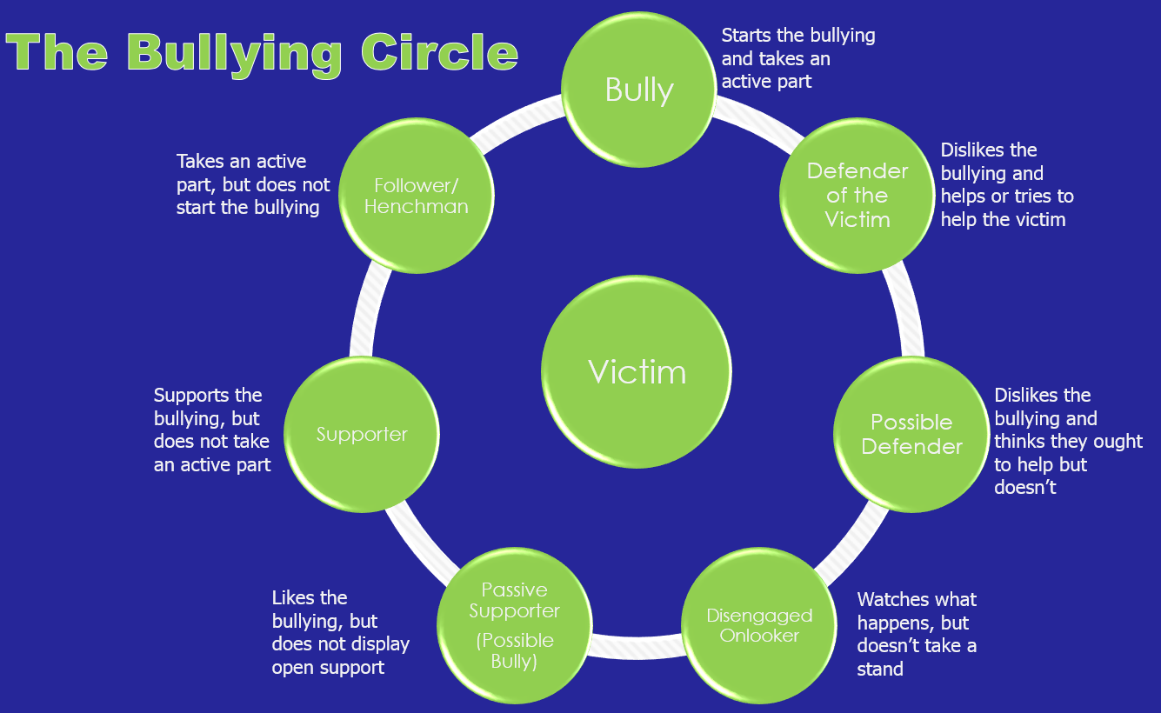
What’s Missing in this Cycle?
What happens to the victim and the bystanders?

Slide 43
Abusive Behaviors, the #1 cause for violent acts targeted towards schools!

Slide 44

Establish A Multidisciplinary Team
Policy should be driving your team; who’s on it, expectations, interventions, plans, and escalations
School Administrators
Counselors?
Law Enforcement?
Assistant Principals?
Dean of Students?
District Teams vs Site Teams

Slide 45
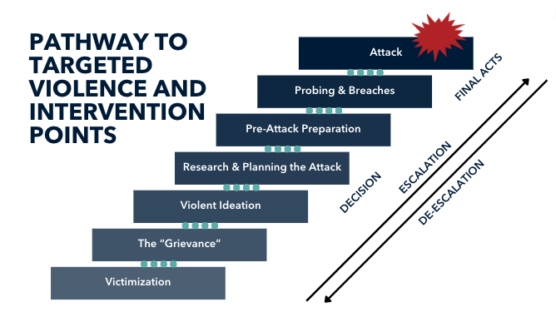
Purpose of the Assessment?
Determine the level of the threat; Not a threat, low-level, concerning, high-level
Determine the APPROPRIATE LEVEL OF INTERVENTION
Ultimately it is to remove the subject from the Pathway to Violence

Slide 47
Concerning Behaviors?
Bullying
Threatening
Fascination with violence as a solution to conflict
Leakage
Violent behavior
Poor conflict resolution skills
Fascination with weapons of any sort
Fascination with tactical gear and attire
Fascination with prior acts of violence
Excessive alcohol or drug use
Behaviors that can place them on the pathway to violence
Any other behaviors that cause you concern

Slide 48
Conducting the Assessment
Initial Assessment - Make an initial determination on the information you received
Determine if immediate action is required
Based on that initial determination, develop your initial plan/objectives
Convene the team necessary to achieve your objectives
Make assignments relative to expertise/capabilities
Gather information and updates
Make secondary determination
Develop Individual Safety Plan (ISP)
Execute ISP
Document and Monitor results

Slide 49
How do we determine the appropriate level of Intervention?
“Threat assessment is a structured group process used to evaluate the risk posed by a student or another person, typically as a response to an actual or perceived threat or concerning behavior.”

Slide 50

What do you do with the assessment?
Intervention?
Discipline?
What about IEPs?
What about the Re-entry Plan?
Monitoring?
Closing?

Slide 51
Use Case #1 - Bonnie and Clyde
Facts
Two HS Juniors in the Engineering Program
Overheard Threatening to kill two teachers (Female)
Assessment conducted
  Prior Incidents
  Band/Misogyny
Results
Determination
Discipline?
Restorative Approach?
Criminal Charges?
Manifestation Hearing?
Suspension/Expulsion?
Mental Health Counseling or referral?
Other?

Slide 52
Use Case #2 - 1st vs 4th
Facts
1st grader threatens to kill fourth grader over Kickball incident
Assessment Conducted?
Results?
Determination
Discipline?
Restorative Approach?
Criminal Charges?
Manifestation Hearing?
Suspension/Expulsion?
Mental Health Counseling or referral?
Other?

Slide 53
Use Case #3 - Steven
Facts
On third call to suicide hotline, threatened to shoot up his HS
Initial determination - High
Assessment Conducted
  15 team members
  Autistic high-functioning
  Pathway to violence - high
  No access
Results
Determination
Discipline?
Restorative Approach?
Criminal Charges?
Manifestation Hearing?
Suspension/Expulsion?
Mental Health Counseling or referral?
Other?

Slide 54

The Secret Ingredient!

Slide 55
Break
Be Back in 15 minutes

Slide 56
Safe2SpeakUp: An Overview

Slide 57
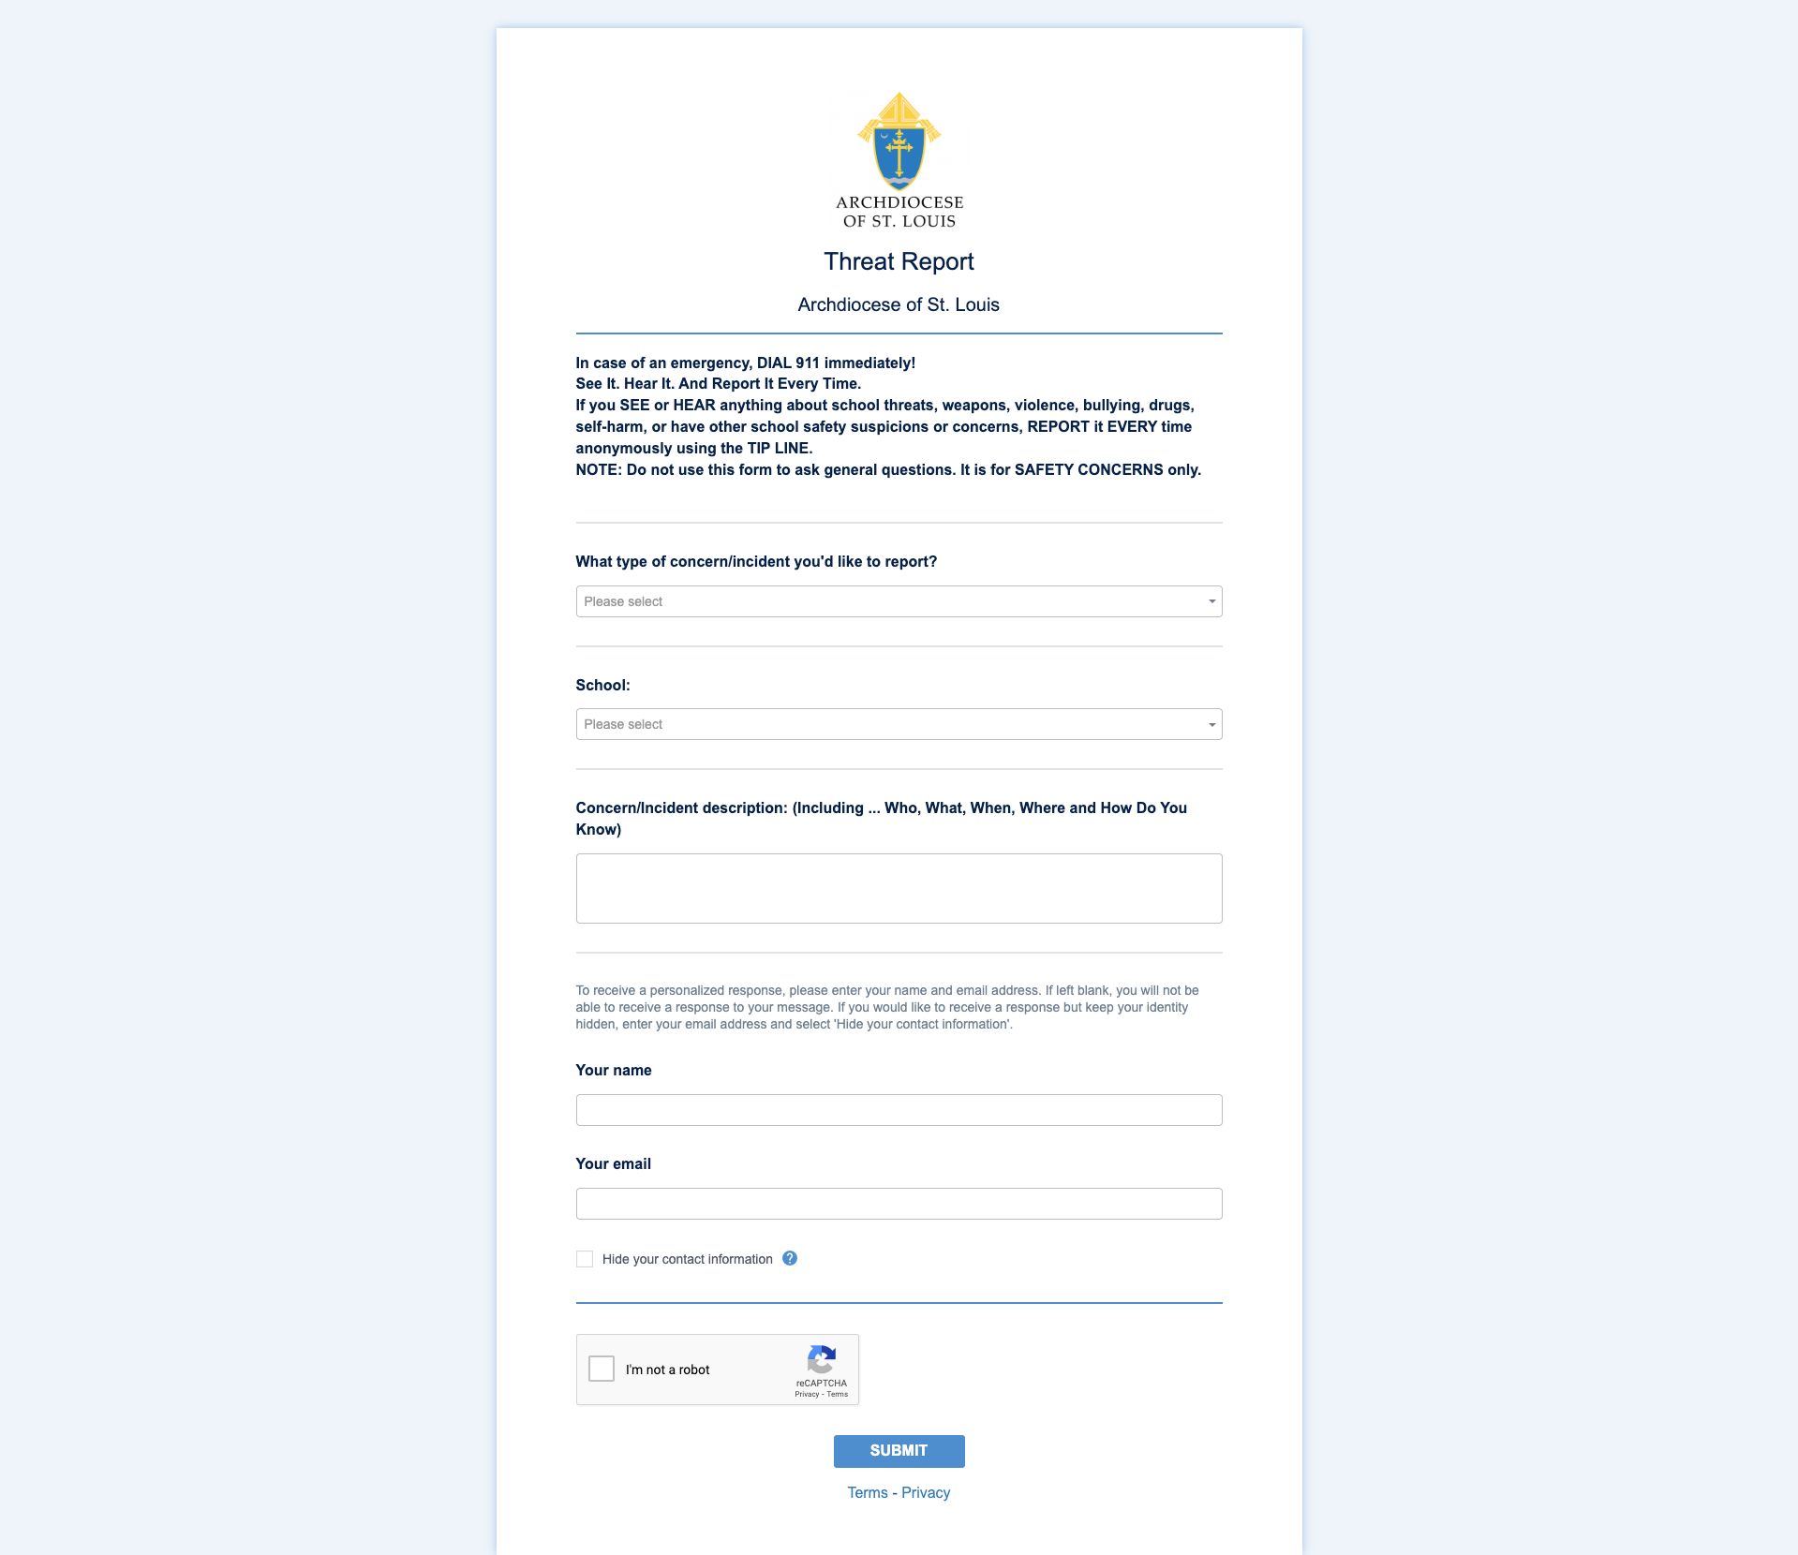
Safe2SpeakUp - Tip Reporting
https://report.crisisgo.net/report?id=xxpdcnsft65uu5hb9zlnkmup2dmcx69k

Slide 58
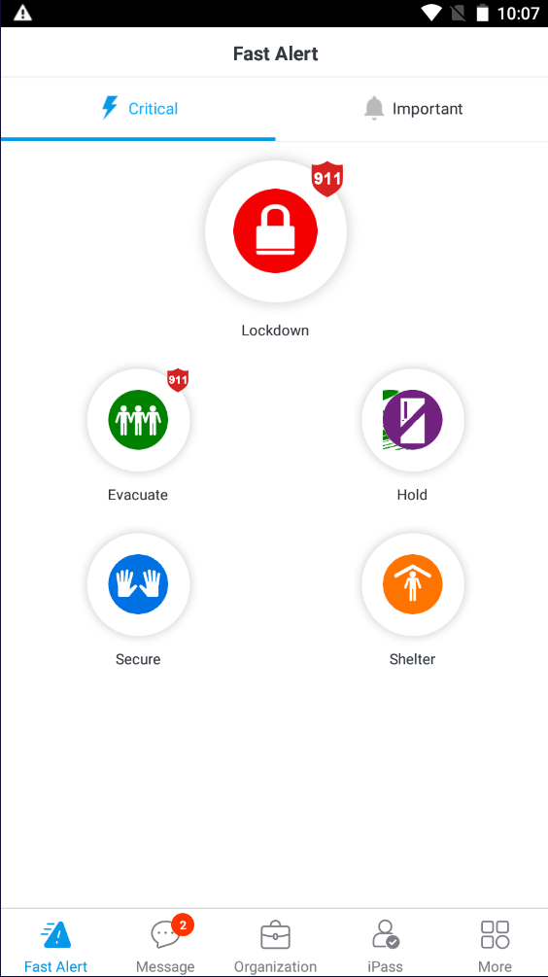
CrisisGo - App (Safety iResponse)

Slide 59

Onboarding Process Overview

Slide 60

Onboarding Project Objectives
Establish Report Receivers for Each Location
Connect CrisisGo with your Staff Information and Student Information
Familiarize School Administrators with CrisisGo Features
Support Initial Deployment of CrisisGo Application

Slide 61
Onboarding Process Steps
School Principals are to complete this form to provide some initial information and trigger CrisisGo to reach out and schedule an onboarding meeting.
The CrisisGo Project Management Team will respond within 2 business days to schedule a meeting with the school administration and Project Team.
  This 30-minute meeting will address any questions that the school administration has and show initial access and settings in their unique CrisisGo application.
  If needed, a demonstration can be performed at the above meeting to help local administration understand the current goals and objectives
  If needed, a meeting between school IT and CrisisGo IT will be scheduled to talk through the sharing of information pertaining to staff and students
Once all staff and students have been added and any customizations have been addressed, the CrisisGo Project Manager will conduct a validation drill/demo with school leadership to ensure conformity and acceptance.
Training materials will be provided in the form of videos, PDF Instruction Guides, PPT, webinars, the in-app learning center, and CrisisGo Academy to assist with deploying to the local staff and students
An Account Manager will be introduced to serve as the point of contact for any escalated needs, questions about enhancements, and to assist with reviewing the adoption and utilization of CrisisGo and it's functionality.

Slide 62
Hotwash
Questions
Review

Slide 63


Blogs and Podcasts
School Safety Blog Series
Coffee With Kelly: A Discussion on School Safety

Slide 64
Questions?
Comments?
Heartburn?
Kelly Moore, CrisisGo
Senior School Safety Specialist
Email: kelly.moore@crisisgo.com
Phone: (805)689-9629

Slide 65
Bonus Topics
Topics that were discussed that were not in the original slide deck

Slide 66
Reunification
Reunification is the process of returning our students and staff to their families in a structured process that allows for control and well documented movement and reunification of family members.
Remember the package delivery service example.
Challenges
Transportation from the impacted site to the reunification site
Policies and Procedures
Drills and Exercises

Slide 67
Reunification Tabletop Exercise
Objectives:
To Identify the steps necessary to complete the reunification process
Identify the challenges within the reunification which need to be addressed
Practice the reunification process
Resources and tools needed:
Go to www.iloveyouguys.org and review the SRM materials provided online
3 or 4 shoe boxes to represent “classrooms”
set of poker chips to represent student, teachers, reunification team and law enforcement (for security)

Slide 68
Reunification Tabletop Exercise
The Process:
The shoe boxes will represent the different stages of the process. Minimally you will need a place where you can receive the students and staff from the impacted school, a parent check-in and a parent/student reunification point
Use the different color poker chips to signify the different roles within the reunification process
Roles can have multiple functions if required
Finally, work through the process.
Initially you will need to document the steps needed. Then you need to identify the challenges that need to be addressed.
Continue this process until you have refined it so it can be implemented

Slide 69
Security and Vulnerability Points
During our discussion we discussed our vulnerabilities on the exterior entry points: drop off and pick-up, playgrounds, sporting events, choke points, etc. The US Secret Service uses the concept of concentric circles. Starting at the point (location, person, asset) that needs protection, they add layers of protection surrounding that point.
The closer you are to the point of protection, the greater your need for protection becomes. The further out you go, the more early warning you need and the less actual protection. This is where the concentric circles come in; they start from the center and identify their protection needs, then add a layer of protection or warning as they identify another decision point: need to protect or warn.

Slide 70
Drills and Tabletop Exercises
Drills and Tabletop exercises are how we train and examine our staff on what they will need to do during an emergency. That being said, it is our administrators and safety team members who have the biggest responsibility during an emergency. They are responsible for running drills and training our staff.
One of the best tools they have available to them is the tabletop exercise. This is where the team sits around a table and runs through scenarios and drills to challenge each other so they can correct any issues with the drill and put themselves in a position to better support the teachers during the drills.

Slide 71
Suggestions to move forward
Challenge yourself to become better problems solvers and focus on solutions, not the challenges
Look for creative solutions and funding opportunities: donations, private/public partnerships
Become an active participant in the safety of your schools, become a student of school safety
If you are in need of help, ask an expert to help
Remember, close to 80% of what we do in school safety is effort and has little or no cost attached to it.
When all else call me: (805)689-9629. I will do what I can to help.
Read my blogs and listen to my podcasts.

